Slide 1
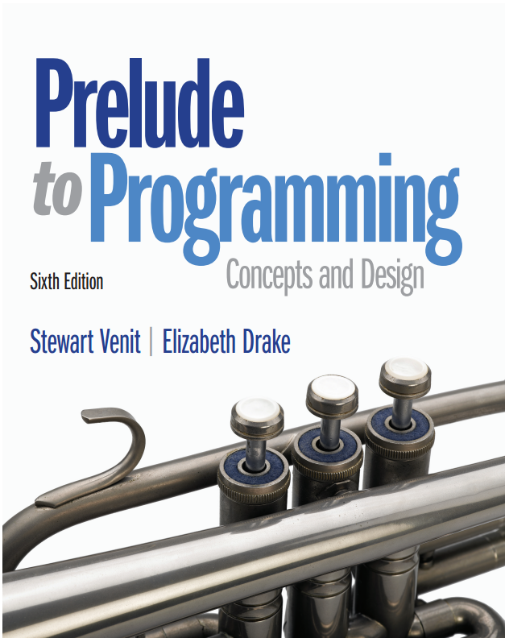
Prelude to Programming
Sixth Edition
Chapter 3
Developing a Program
Copyright © 2015, 2011, 2009 Pearson Education, Inc. All Rights Reserved
Notes:
If this PowerPoint presentation contains mathematical equations, you may need to check that your computer has the following installed:
1) MathType Plugin
2) Math Player (free versions available)
3) NVDA Reader (free versions available)

Slide 2
3.1 The Program Development Cycle

Slide 3
3.1 The Program Development Cycle
Problem solving principles
Completely understand the problem
Devise a plan to solve it
Carry out the plan
Review the results
Writing a program
1) Analyze the problem
2) Design the program
3) Code the program
4) Test the program

Slide 4
1. Analyze the problem
Identify desired results (output)
Determine input needed to produce those results
Example: Create a program to generate 6 numbers to play the lottery
Is 7, 7, 7, 7, 7, 7 ok?
Is −3, 0, 8, 9, 689, 689 ok?
Is 1, 2, 6, 47.98765, 88, 93.45 ok?
These are all 6 numbers but we see we must be more specific
Desired results: 6 different positive integers within the range of 1 to 40

Slide 5
2. Design the program
Create a detailed description of program
Use charts, models, or ordinary language (pseudocode)
Identify algorithms needed
Algorithm: a step-by-step method to solve a problem or complete a task
Algorithms must be:
Well defined
Well ordered
Must produce some result
Must terminate in a finite time

Slide 6
3. Code the program
Translate charts, models, pseudocode, or ordinary language into program code
Add statements to document what the code does
Internal documentation
External documentation
Each programming language uses its specific syntax

Slide 7
Syntax
Correct syntax for telling your friend where you put a cheese sandwich is:
“I have put it on the table.”
Incorrect use of English syntax to say:
“I have it on the table put.”
All the right words are there, but without proper syntax, the sentence is gibberish in English.
But translated word for word, the second sentence is correct syntax in German.

Slide 8
4. Test the program
In analysis phase: continually ask questions
Did I interpret data correctly?
Does program fulfill requirements?
Are my formulas or procedures correct? Etc…
In design phase: use desk-checking to walk through the program
In coding phase: software will alert you to errors in syntax but not in the logic of the program
Finally, test your program with as many sets of test data as possible
Use good data, bad data, data you know the answers for, etc.

Slide 9
Additional Steps in the Cycle
Create an outline of the program so that it is apparent what major tasks and subtasks have to be accomplished and the relationships among these tasks
Describe in detail how each of these tasks is to be carried out
To put a commercial program (produced by a software publishing company) you may need to:
Create a user’s guide
to help users can understand the intricacies of the program
Create help files
installed with the software for users to get on-screen help
Train employees to provide telephone or web-based customer support
Duplicate disks and accompanying materials for distribution
Advertise the program to attract buyers

Slide 10
Program Development is a Process
Program development is a cyclical process that often requires returning to earlier steps and, with complex programs, may take many months
The design process may uncover flaws in the analysis
Coding may find problems leading to modifications or additions to the design
Testing inevitably uncovers problems that require returning to previous phases

Slide 11
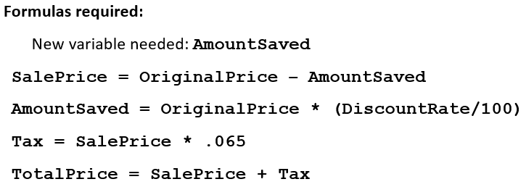
The Sale Price Example
A local department store wants to develop a program which, when given an item’s original price and the percentage it is discounted, will compute the sale price, with sales tax.
Output required: name of item, discounted price, amount of sales tax, total price
Variables needed: ItemName, SalePrice, Tax, TotalPrice
Input required: name of item, original price, percent discounted
More variables: OriginalPrice, DiscountRate

Slide 12
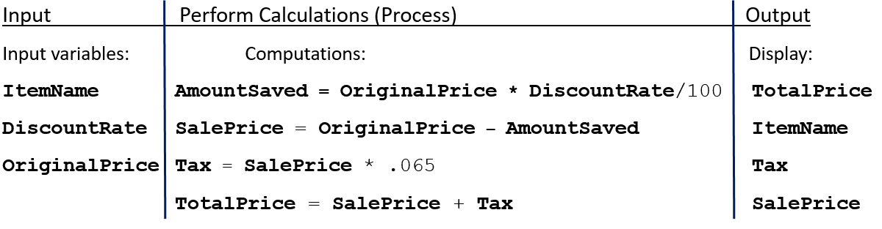
Design: Input → Processing → Output

Slide 13
3.2 Program Design

Slide 14
3.2 Program Design
Modular Programming
To begin designing a program: identify the major tasks the program must accomplish.
Each of these tasks becomes a program module.
if needed, break each of these fundamental “high-level” tasks into submodules
Some submodules might be divided into submodules of their own
this process can be continued as long as necessary
Identifying the tasks and subtasks is called modular programming

Slide 15
Using Modules and Submodules
A module performs a single task.
A module is self-contained and independent of other modules.
A module is relatively short. Ideally, statements should not exceed one page.
Benefits of Modular Programming
program is easier to read
easier to design, code, and test the program one module at a time
different program modules can be designed and/or coded by different programmers
a single module may be used in more than one place in the program
modules that perform common programming tasks can be used in more than one program

Slide 16
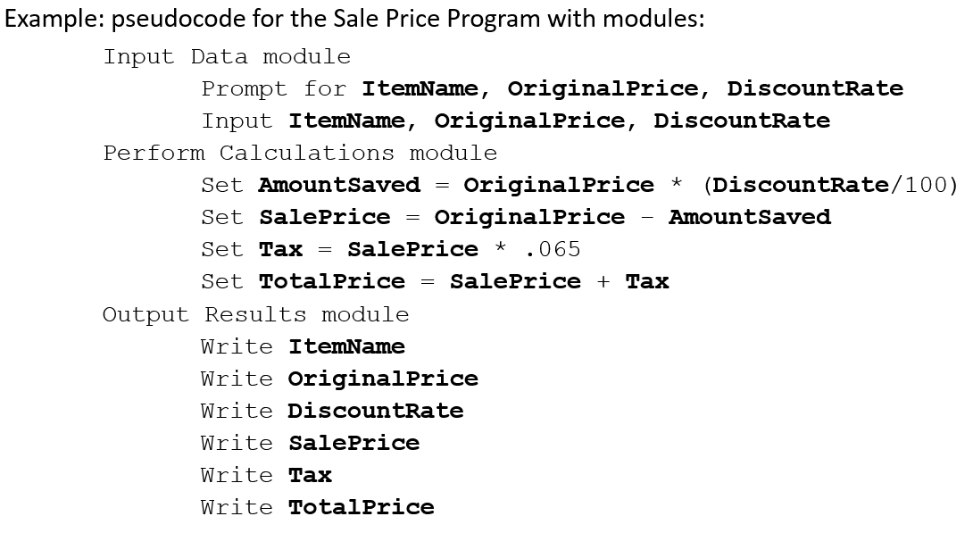
Pseudocode: uses short, English-like phrases to describe the outline of a program

Slide 17
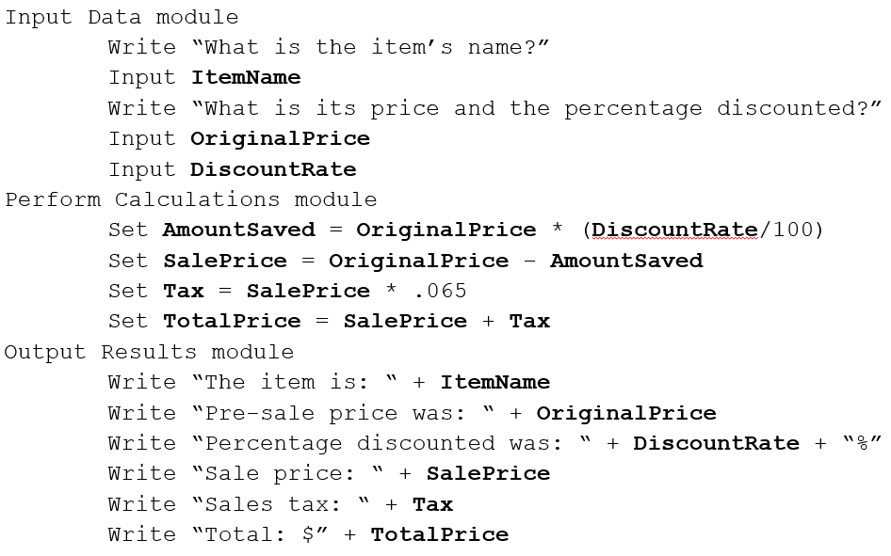
Refined Pseudocode for the Sale Price Program

Slide 18
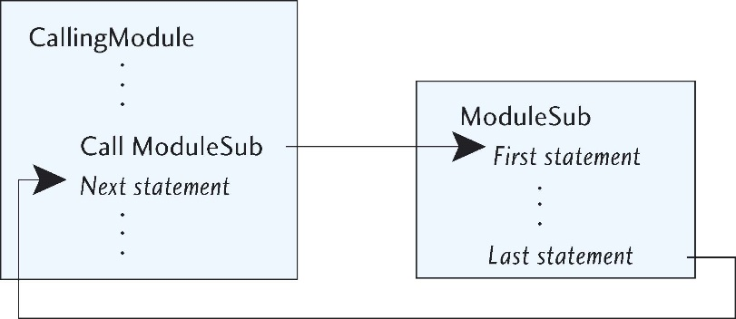
Calling Modules
A call statement causes a submodule to be executed.
After a call statement, program control is transferred to the first line of the called module.
After all statements in the submodule have been executed, control returns to the line of code immediately below the call statement.

Slide 19
The Main Module
The main module is where program execution begins and normally ends.
The main module is not a submodule of another.
It is the parent module of the program’s highest-level modules.
The highest-level modules are called into action by the main module.
In the Sale Price Program, we add a Main module to call others:
Main module:
Call Input Data module
Call Perform Calculations module
Call Output Results module

Slide 20

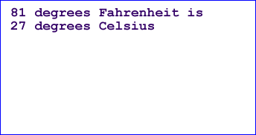
Format Output
Include information about what the output means
If a program calculates the temperature converted from Fahrenheit to Celsius, the following output is confusing:
But the following output makes more sense:

Slide 21
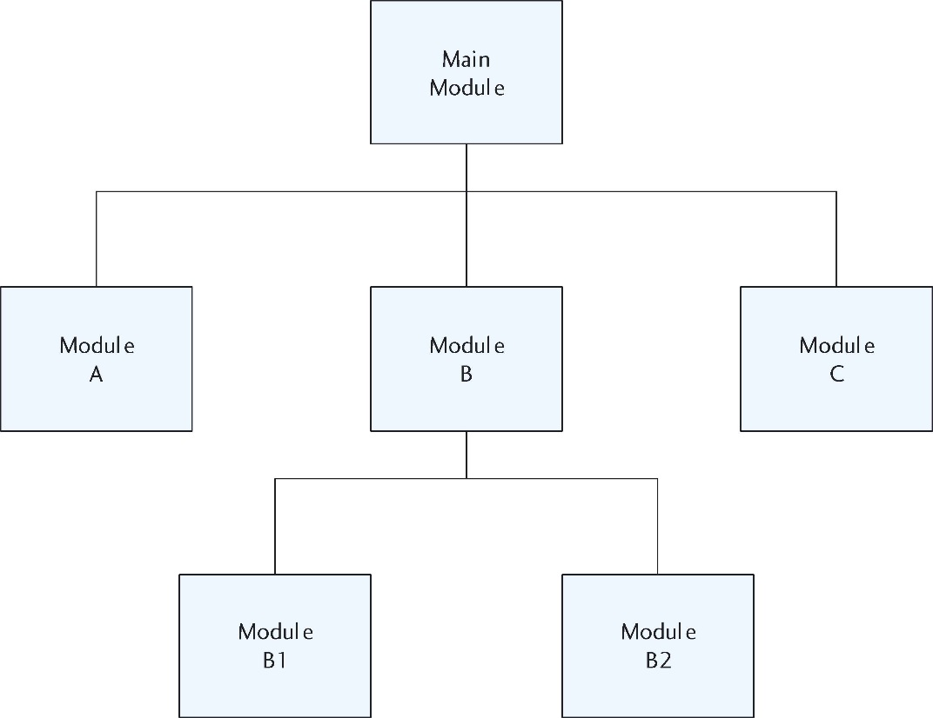
Hierarchy Charts
Like an organization chart
Shows position of modules in the program
Depicts what modules exist and how they are related
Large programs need a “map” for documentation

Slide 22
3.3 Coding, Documenting, Testing

Slide 23
3.3 Coding, Documenting, Testing
Coding
Coding is done in a specific programming language. We will use pseudocode.
This phase should only begin after a solid design exists.
Documenting
Code needs to contain documentation that describes to the reader what the code is doing
Two types of comments are used within the code
Internal documentation is for the programmers to read
External documentation is for the user

Slide 24
Comments: Not Processed by the Computer, Valued by Other Programmers
Header comments
Appear at beginning of a program or a module
Provide general information
Step comments or in-line comments
Appear throughout program
Explain purpose of specific portions of code
Often comments delineated by:
//
/* comment goes here */

Slide 25
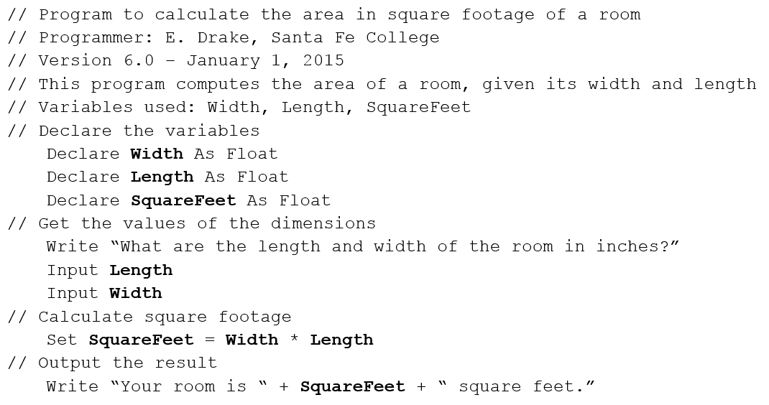
Using Comments for a Program to Find Size of a Room

Slide 26
The Testing Phase
Testing
Create test data that will be used to check the program’s correctness.
Use desk checking (or walking through a program by hand with a set of data that you know the answer to).
Check that the program will catch errors by using test data designed to create errors.
The more testing of various types of data you can use, the more likely you are to have a program that is free of errors.

Slide 27
Types of Errors: Syntax Errors
Syntax errors: a violation of the programming language’s rules for creating valid statements
May be caused by incorrect grammar or punctuation, or misspelling a keyword
The program will not run at all with syntax errors

Slide 28
Types of Errors: Logic Errors
Logic errors: the program runs, but does not produce the expected results
May be caused by using an incorrect formula, or incorrect sequence of statements, etc.
Sometimes called runtime errors
Can be detected during the desk checking phase of the programming cycle

Slide 29
3.4 Commercial Programs: Testing and Documenting

Slide 30
3.4 Commercial Programs: Testing and Documenting (1 of 2)
External documentation
Purposes:
Documentation in a user’s guide or on-screen help system provides information about the program for the end users
Documentation in a maintenance manual provides information about how the program code accomplishes its purposes

Slide 31
3.4 Commercial Programs: Testing and Documenting (2 of 2)
User’s Guides:
usually written during alpha or beta test phases by a technical writer
Documentation for other programmers:
Program maintenance manual
For programming experts
Used to help them fix or enhance code written by other programmers
Design documentation
Written by programmer to explain rationale behind methods and code used
Trade Study documentation
A research tool
An attempt to find the best solution

Slide 32
3.5 Structured Programming

Slide 33
3.5 Structured Programming
A method for designing and coding programs in a systematic, organized manner
It combines the principles of top-down design, modularity and the use of the three accepted control structures: sequence, repetition and selection
Sequence, repetition and selection can be expressed in pseudocode, or with flowcharts

Slide 34
Flowcharts
A tool for programmers to design programs
Describes the flow of a program module’s execution with diagrams
Completely different from hierarchy charts
Connected symbols are used to describe sequence, repetition, and selection structures
Some prefer to use flowcharting to learn how to express algorithms, and others prefer to use pseudocode
Many programs are designed with a combination of pseudocode and flowcharts

Slide 35
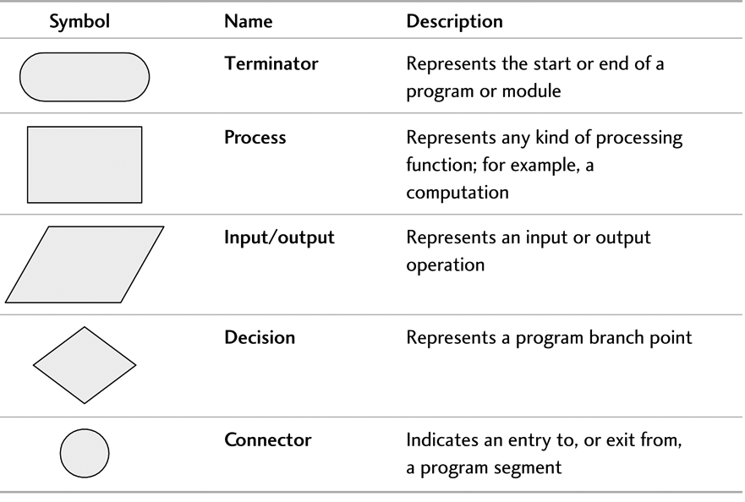
Basic Flowcharting Symbols

Slide 36
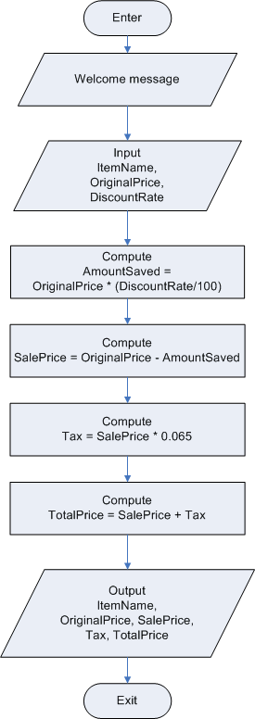
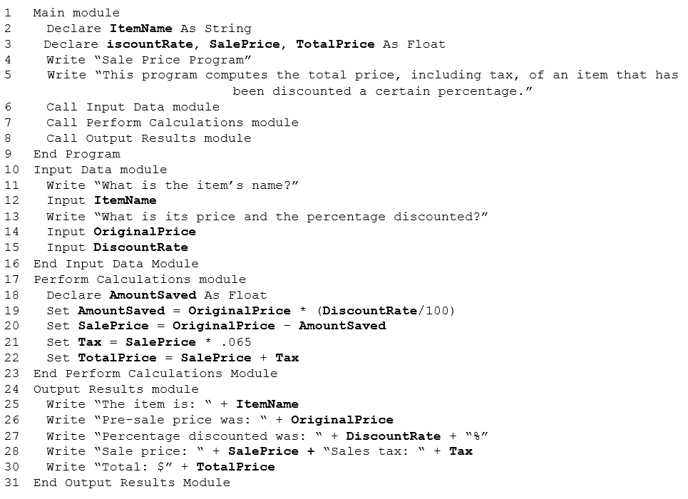
Example 3.10 Comparing Pseudocode and Flowcharts

Slide 37
Control Structures
In the 1960s computer scientists proved there are only 3 basic control structures (also called constructs) needed to create any program or algorithm!
Sequence - execute statements in sequential order
The simplest of control structures - start at the beginning and continue in sequential order
Selection - selectively execute statements
Also called a branch or decision
requires a condition to determine when to execute statements
Repetition - repeat statements more than once
Also called a loop
needs a stop condition, i.e, the program will continue to loop until some condition is met

Slide 38
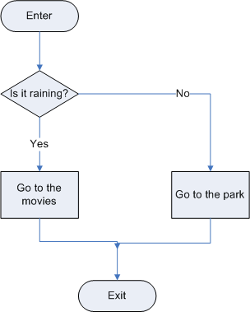
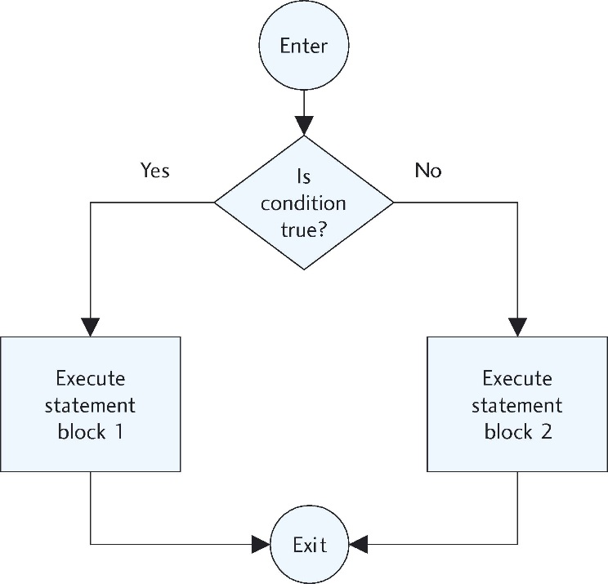
Flowchart for Typical Decision (Selection) Structures

Slide 39
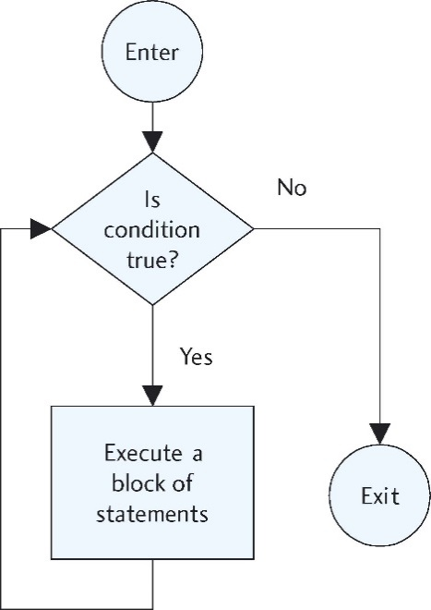
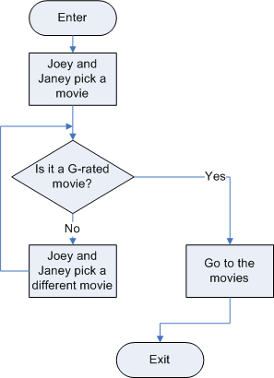
Flowchart for Typical Repetition (loop) Structures

Slide 40
Style Pointers
Write modular programs
Use descriptive variable names
Provide a welcome message for the user
Use a prompt before an input
Identify program output
Document your programs

Slide 41
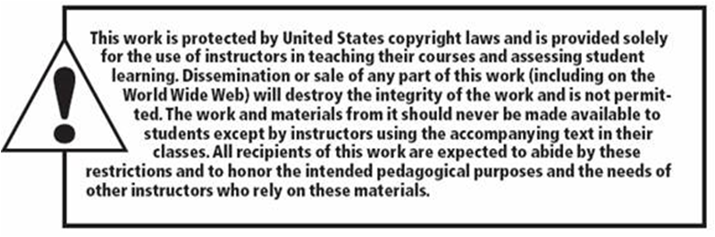
Copyright

